Slide 1

Data Analysis with R Programming
Deepankar Sharma

Slide 2

Course Outcomes
In this course, you’ll learn about the programming language known as R. You’ll find out how to use RStudio, the environment that allows you to work with R. This course will also cover the software applications and tools that are unique to R, such as R packages.

Slide 3
Data Analysis
Data analysis is the process of cleaning, changing, and processing raw data and extracting actionable, relevant information that helps businesses make informed decisions.

Slide 4
Programming with R
R is a programming language that can help you in your data analysis process.
RStudio is the environment you’ll use to work in R.
Using R can help you complete your analysis efficiently and effectively.
The R programming language was designed to work with data at all stages of the data analysis process.

Slide 5
Why R ?
R is free and open source, so it is widely accessible
It has a large and active user community, so there are many resources available for learning and troubleshooting
R has a vast number of libraries and packages available for statistical computing and data analysis

Slide 6
Data Wrangling with R
Also known as data munging, is the process of cleaning and transforming raw data into a format suitable for analysis
It involves tasks such as removing duplicates, filling in missing data, and transforming data types ( vectors, matrices, arrays, data frames, and lists )
Wide range of functions for manipulating data, such as subsetting, merging, and transforming data frames (Tidyverse: dplyr and tidyr)

Slide 7
Data Visualization with R
Why visualize data? (understand data: identify patterns, trends, and outliers in the data)
Different types of plots in R programming (Histogram, Scatter Plot , Box Plot, ...)
How to create visualizations using R programming? (Tidyverse: ggplot2 and plotly)

Slide 8
Machine Learning with R
Machine Learning (learn from data and make predictions or decisions without being explicitly programmed)
Wide range of libraries in R (caret, mlr, and randomForest)

Slide 9
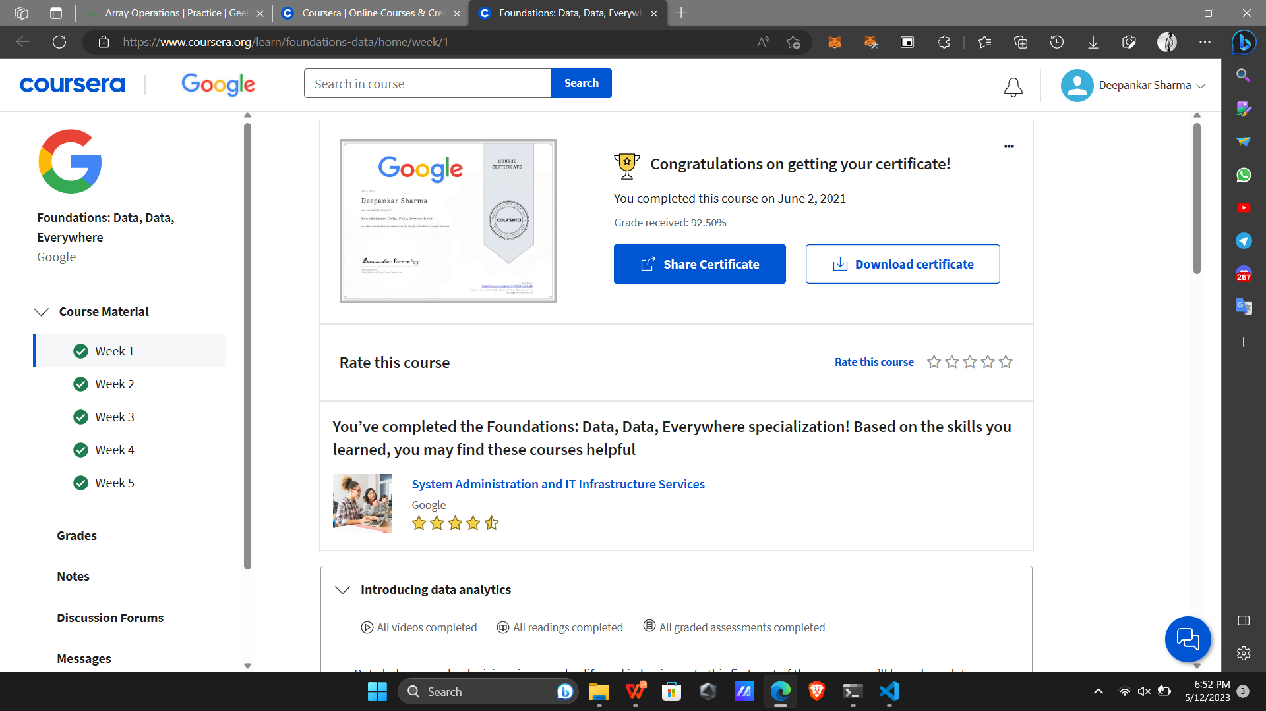
Completion

Slide 10
Conclusion
Summary of the course
Future scope of data analytics with R programming
Resources for further learning ( Google Data Analyst Profession Certificate )

Slide 11
Thank You !!!

